Slide 2
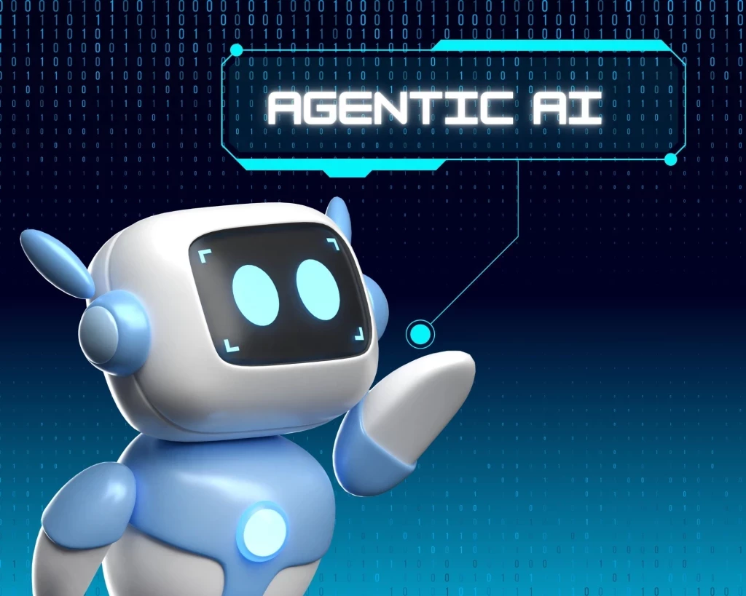
Agentic AI: An Introduction
An AI Agent refers to a system or programs that is capable of autonomously performing tasks on behalf of a user or another system by designing its workflow and utilizing available tools.
AI Agents can encompass a wide range of functionalities beyond Natural Language Processing including decision-making, problem-solving, interacting with external environments and executing actions.

